Slide 1


COMPUTER NETWORKS
Topic:
DESIGN ISSUES OF NETWORK LAYER
24CS2202
Session-16

Slide 2



AIM OF THE SESSION
To familiarize students with the concepts of NETWORK LAYER DESIGN ISSUES.
INSTRUCTIONAL OBJECTIVES
This Session is designed to:
Describe the Design Issues of network layer.
Describe the concepts of Store-and-Forward Packet Switching,Services Provided to the Transport Layer,Implementation of Connectionless Service,Implementation of Connection-Oriented Service and Comparison of Virtual-Circuit and Datagram Networks
LEARNING OUTCOMES
At the end of this session, the student will be able to:
Understand the design issues of Nework layer.
Identify the difference bertween connection oriented service and connection less service .

Slide 3
AGENDA
Design issues of NETWORK LAYER
Difference between COS & CLS

Slide 4
NETWORK LAYER
The network layer is concerned with getting packets from the source all the way to the destination.
To achieve its goals, the network layer must know about the topology of the network and choose appropriate paths through it, even for large networks.
There are some of the issues that the designers of the network layer must grapple with.
These issues include the service provided to the transport layer and the internal design of the network.

Slide 5
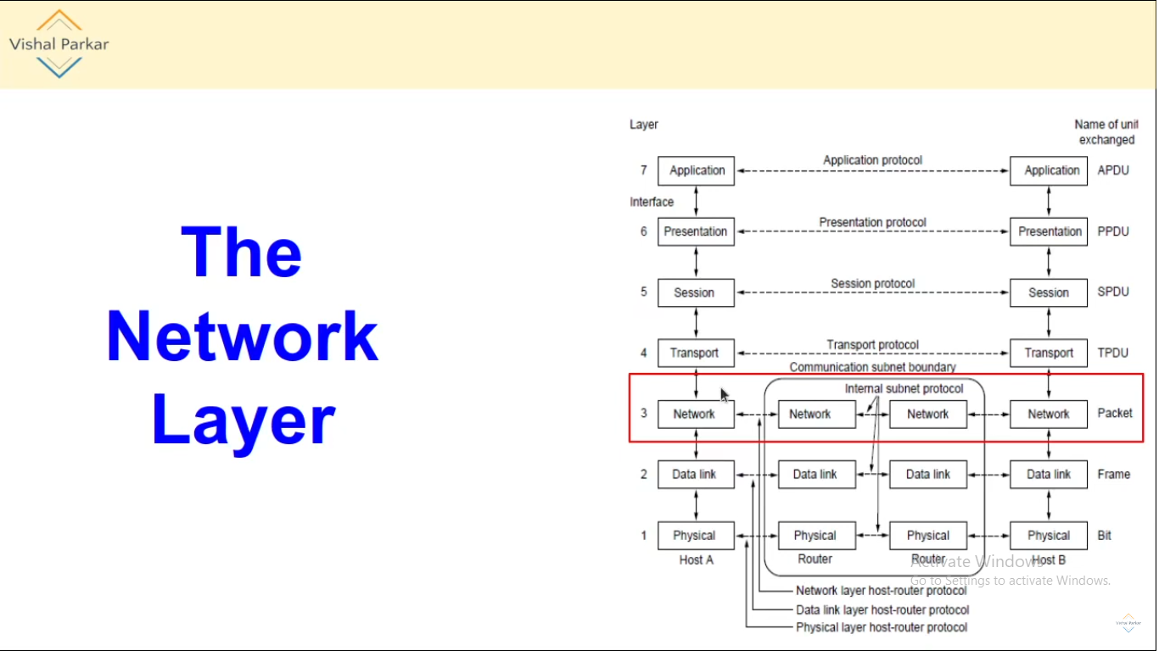

Slide 6
DESIGN ISSUES OF NETWORK LAYER
Store-and-Forward Packet Switching
Services Provided to the Transport Layer
Implementation of Connectionless Service
Implementation of Connection-Oriented Service service
Comparison of Virtual-Circuit and Datagram Networks

Slide 7
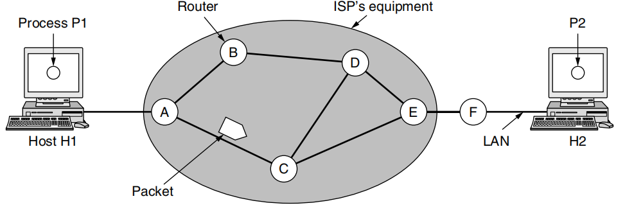
Store-and-Forward Packet Switching
The environment of the network layer protocols

Slide 8
Services Provided to the Transport Layer
The services should be independent of the router technology.
The transport layer should be shielded from the number, type, and topology of the routers present.
The network addresses made available to the transport layer should use a uniform numbering plan, even across LANs and WANs.

Slide 9
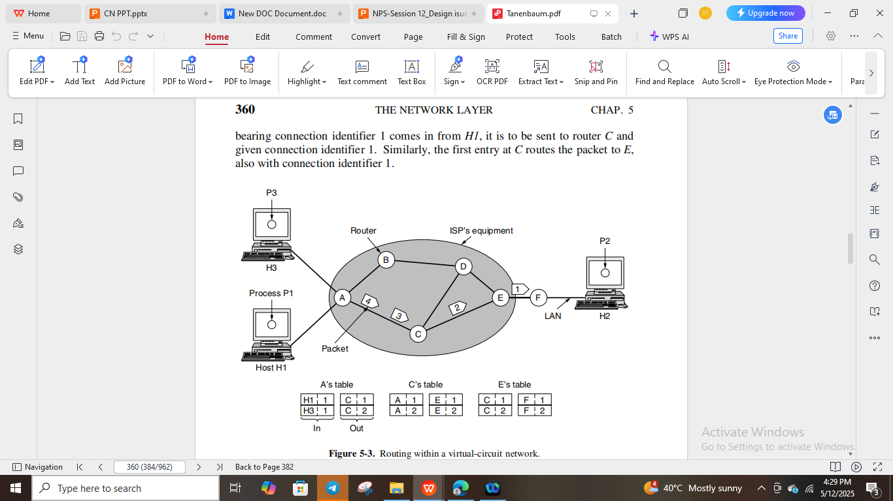
Implementation of Connection-Oriented Service
Routing within a virtual-circuit network.

Slide 10
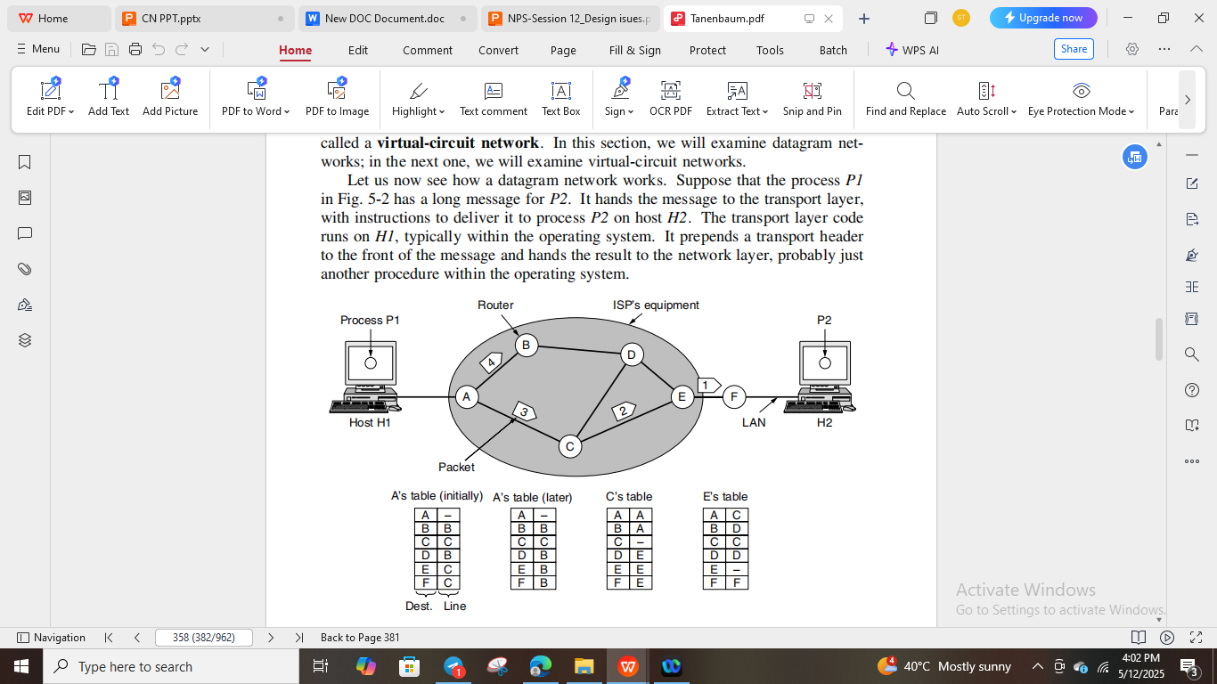
Implementation of Connectionless Service
Routing within a datagram network

Slide 11
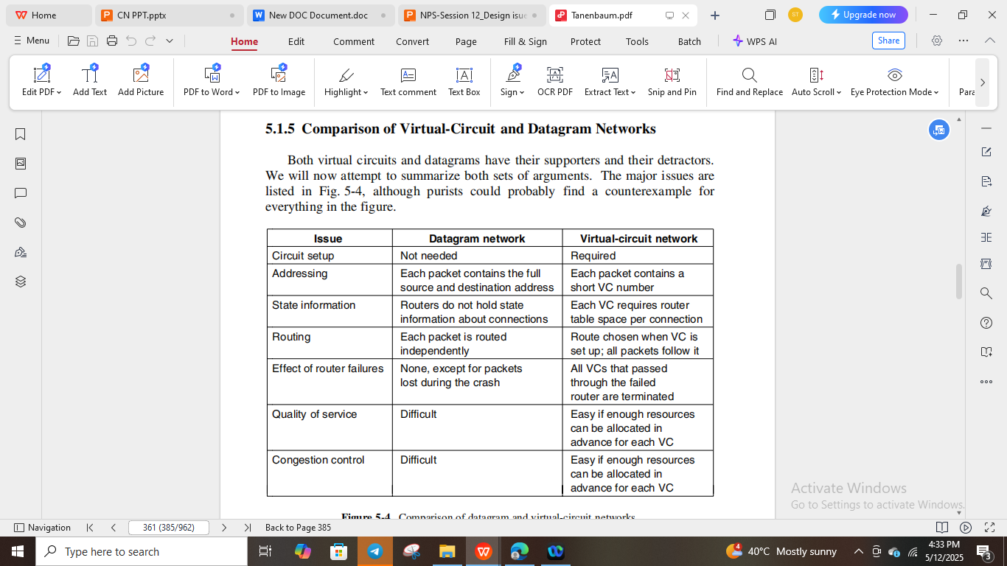
Comparison of Virtual-Circuit and Datagram Networks

Slide 12
TERMINAL QUESTIONS
1. Describe the design issues of Network layer.
2. Explain the implementation of connection-oriented and connectionless services by network layer.
3. Compare virtual circuit and datagram subnet.

Slide 13
REFERENCES FOR FURTHER LEARNING OF THE SESSION
Reference Books:
Behrouz A. Forouzan , “Data Communication and Networking”, TMH, 5th Edition, 2012.
A.S. Tanenbaum, David J. Wetheral “Computer Networks” Pearson, 5th Edition.

